Slide 1
Subject Matter
What is it saying?

Slide 2
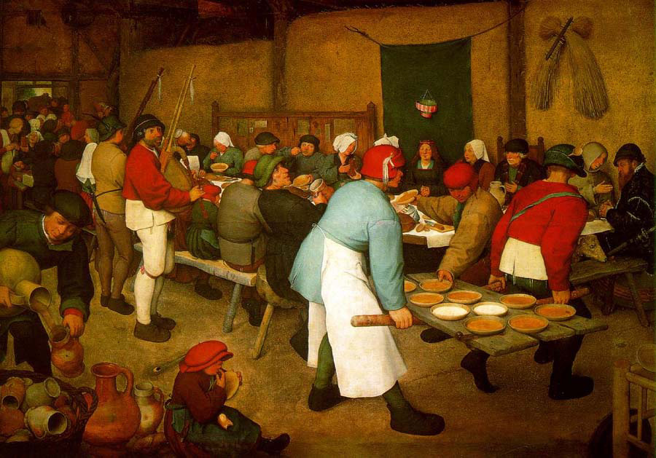
Peter Brueghel, Peasant Wedding
Narrative Subject: the artist is telling a story

Slide 3
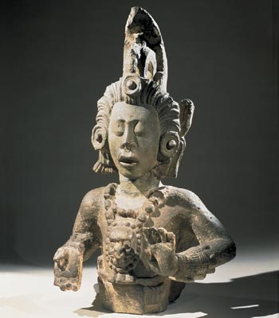
Maize God, from Temple 22, Maya, Copan, Honduras
Religious
Subject: any religious figure or object

Slide 4
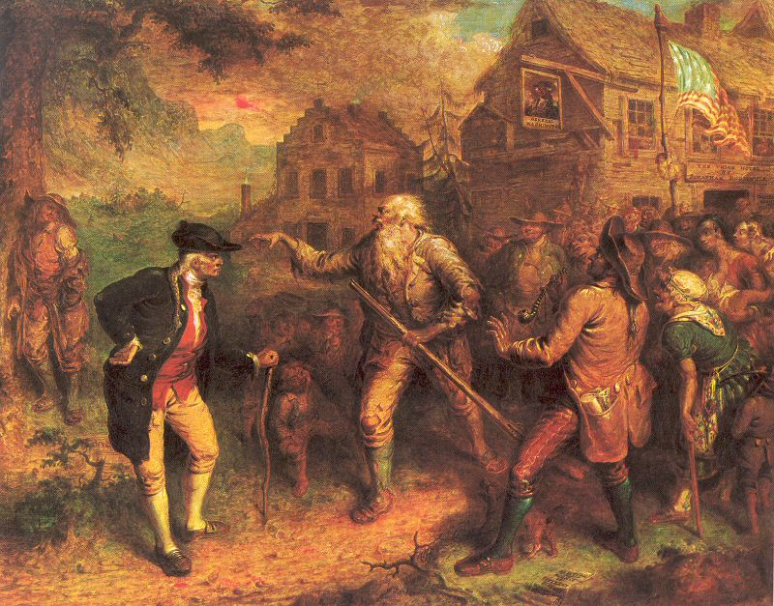
John Quidor, The Return of Rip Van Winkle
Literary Subject: artists use literary sources such as the bible, famous myths and legends, and stories to get ideas

Slide 5
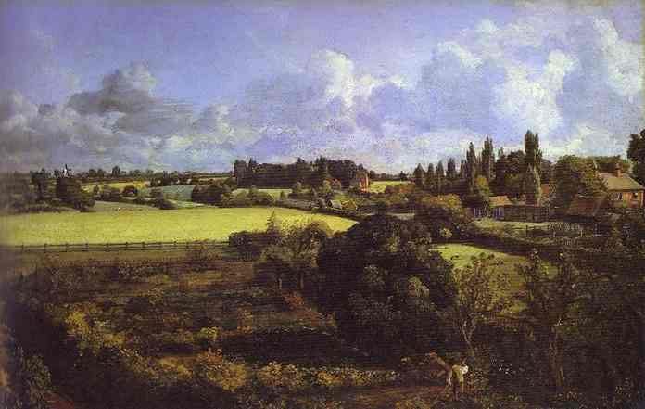
John Constable, Golding Constable's Kitchen Garden
Landscape: paintings of the natural environment

Slide 6
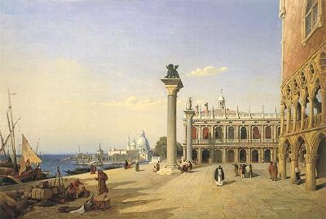
Jean-Baptiste-Camille Corot, View of Venice
Cityscape: views of urban environment, streets, plazas, buildings…, man made things

Slide 7
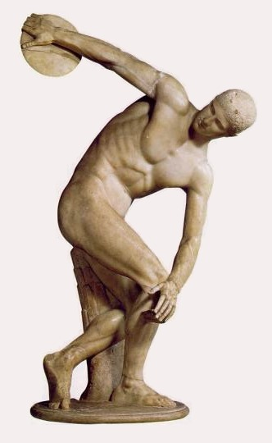
Myron, Discus Thrower
The Figure: the human body depicted nude or partially nude

Slide 8
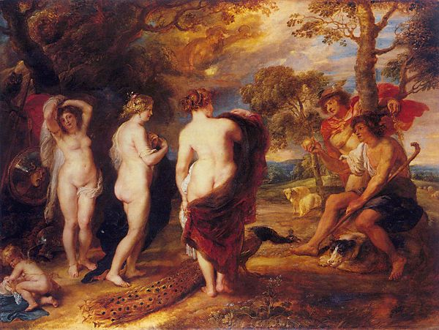
Peter Paul Rubens, The Judgment of Paris

Slide 9
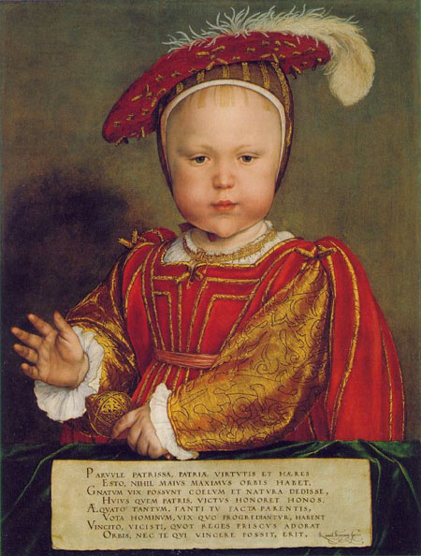
Hans Holbein, Edward VI as a Child
The Portrait: representation of a person or people

Slide 10
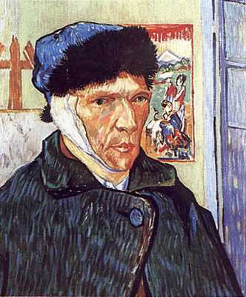
Self-Portrait:
the artist creates a representation of themselves

Slide 11
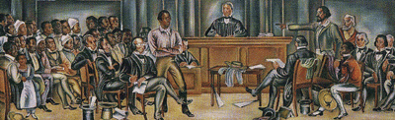
Hale Wodruff, The Amistad Slaves on Trial at New Haven,
Historical Subjects: speak about or record history

Slide 12
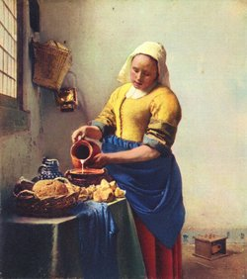
Vermeer, The Milkmaid
Genre: everyday activities of normal people

Slide 13
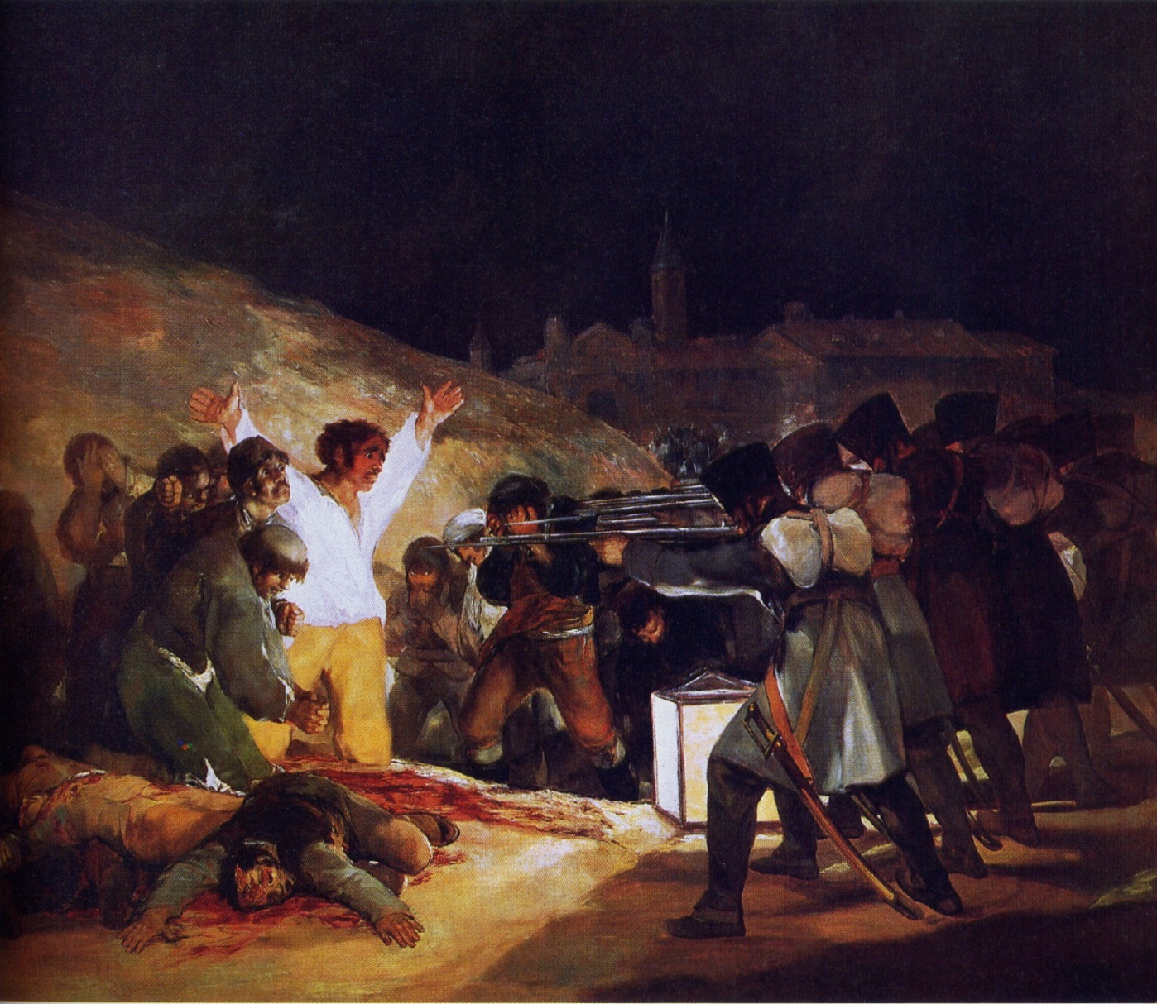
Francisco Goya,
The Third of May, 1808, 1814
Social Comment: visual statements about society, the world, may criticize leaders, churches, wars, politics…

Slide 14
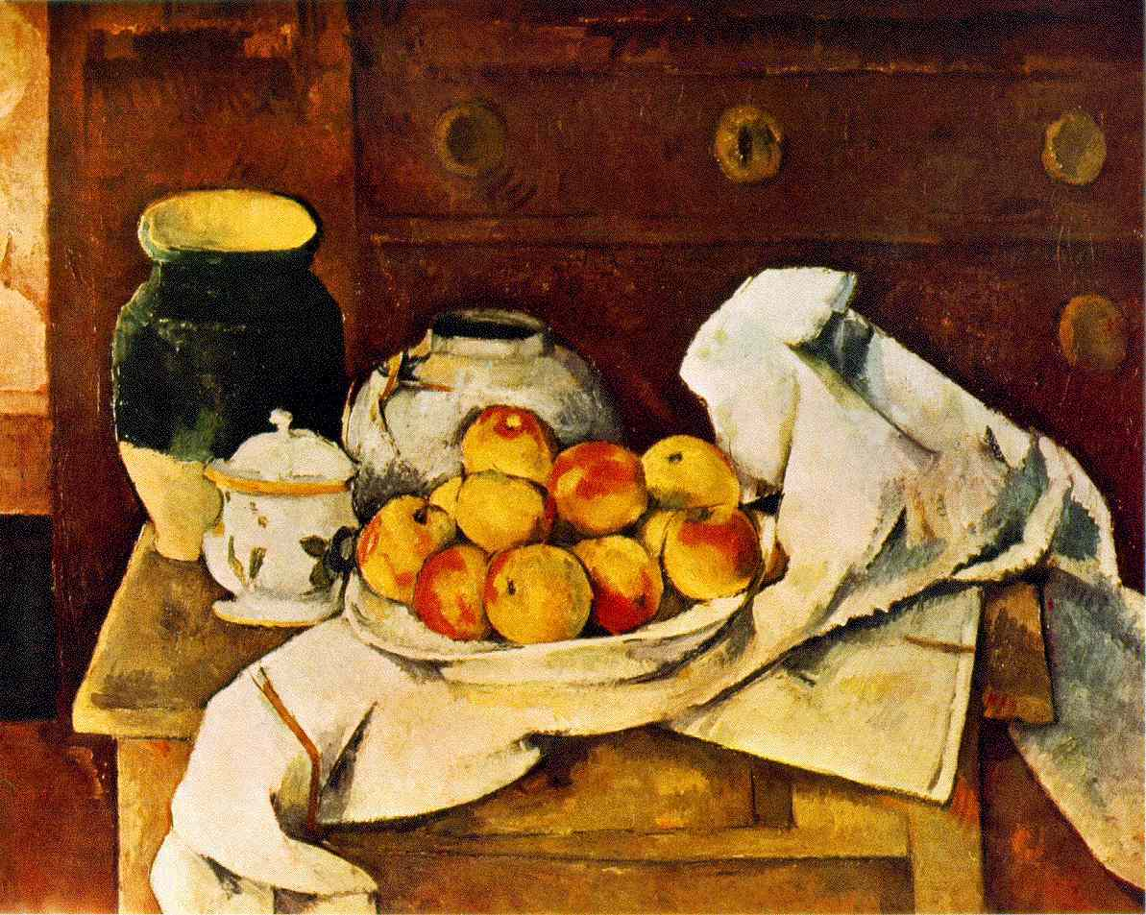
Cezanne, Still Life with Peaches
Still Life: a painting of inanimate objects, objects are arranged by the artist

Slide 15
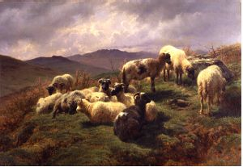
Rosa Bonheur, Sheep in the Highlands
Animals: people have always been intrigued by animals

Slide 16
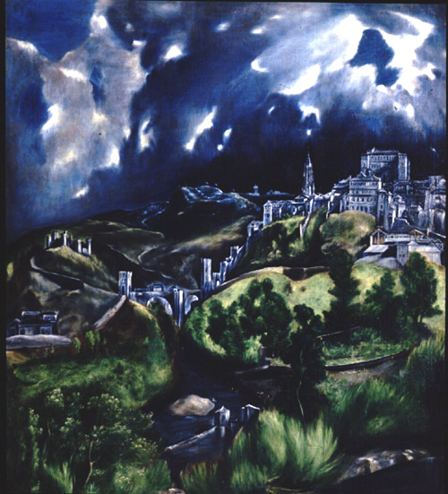
El Greco, View of Toledo
Expression: the artist includes feelings about subjects, personal and emotional feelings

Slide 17
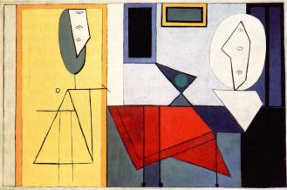
Picasso, The Studio
Abstraction: simplification of subject matter into basic and often geometric shapes, objects are still recognizable

Slide 18
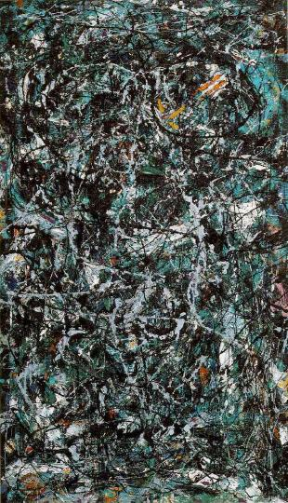
Jackson Pollock, Full Fathom Five
Non-objective painting: no recognizable elements or objects.

